Slide 1

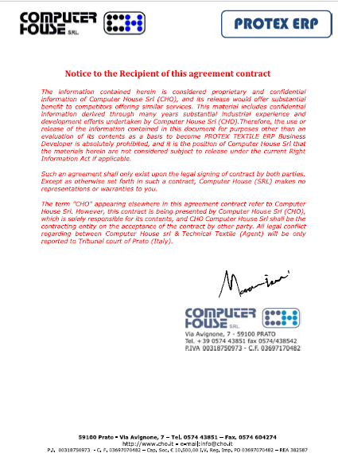

Slide 2

REAL-TIME ERP® by
Dated March 20, 2018 rev 06

Slide 3

Our Introduction
“REAL-TIME ERP®” is a joint venture of Technical Textiles & INZ Tech Services
Technical Textile is a platform bringing together highly qualified textile professionals working on development of different textile products in their own respective fields.
Technical Textiles have vast experience of different textile sectors in a vertical textile mills.
INZ Technological Services is an automation solution provider
Successfully developed & implemented “Loom Data Weaving Monitoring System” on more than 10,000 looms
Clients list is more than 100 textile mills in Pakistan, Bahrain and Bangladesh.

Slide 4
Journey to Future ( Digital Front )
REAL-TIME ERP®
Modules are from fiber to stitched goods.
“REAL-TIME ERP” is divided in to sub modules.
All modules can be integrated at any level.
In most of the cases information/data collected is real time and directly from machines.
Most of the data collection is from the source and through wireless mode
Summarization of big data is presented to management on Customized Dashboard. KPIs are also available on mobile devices.
Enables management to see, analyze and take quick action on variance.
Optimize labor productivity, machine efficiency, quality of product in energy efficient manner.

Slide 5

REAL-TIME ERP®
Spinning
HRMS
Weaving
Finance
Cost control
Knitting
REAL-TIME ERP®
Supply Chain
Dying / Finishing
Quality Control
Stitching
Quality Management

Slide 6
REAL-TIME ERP®
Machine Management
HRMS
Material Management
REAL-TIME ERP®
CRM
Accounts &
Cost control
Supply Chain
Quality Management
Quality Control

Slide 7
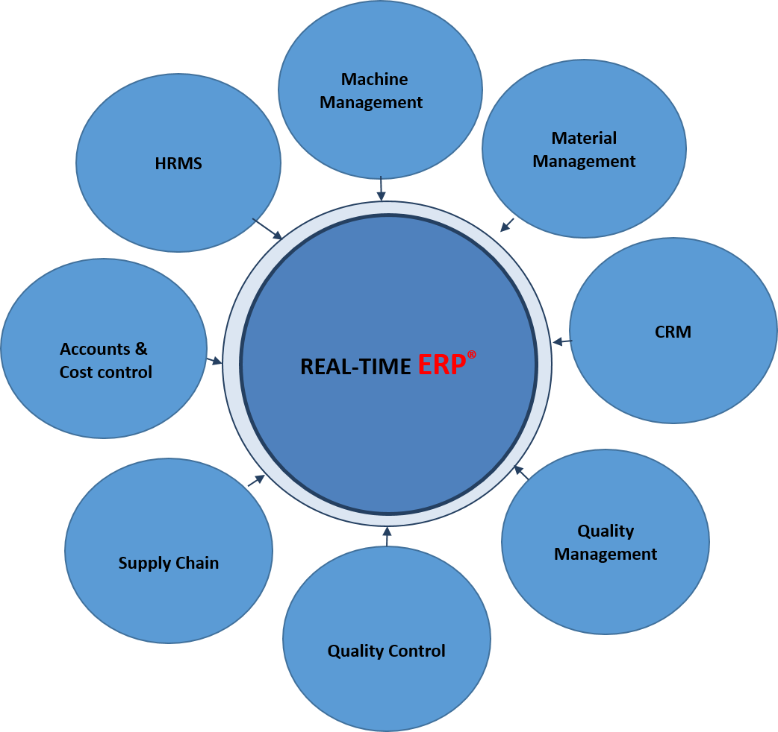
8 Sectors
8 Modules
Spinning
Weaving
Knitting
Fabric dying
Printing
Embroidery
Knit dying
Stitching

Slide 8
REAL-TIME ERP®
Executive Dashboard (Spinning Mills) Level 1
Head Count
Permanent
Contractual
Man/mc Ratio
Salary and Wage Bill
Accounting & Cost Control
Material Management
Machine Management
Quality Control
Management System
S C
CRM
HR
Actual
P/L & B/S
Tentative
P/L & B/S
Cost Control with Alarms
Energy
Payroll
Stores
Admin
Order management
Production
Yield
Machine Utilization %
Machine
Prod m/min
Machine Prod Kg/hr
Maintenance
Schedule
Maintenance
Break Downs
EMS
RH & Temp
On Line Data
Off Line Testing
Off Live survey
Quality Testing Scheduler
Vision &
Mission
Training
Audits
Management Review
Certification
Cotton
Yarn
General Stores.
Waste
Supplier
Controlls
Purchase
Order management
Gantt Chart
Spin Plan & Optimization
Costing

Slide 9
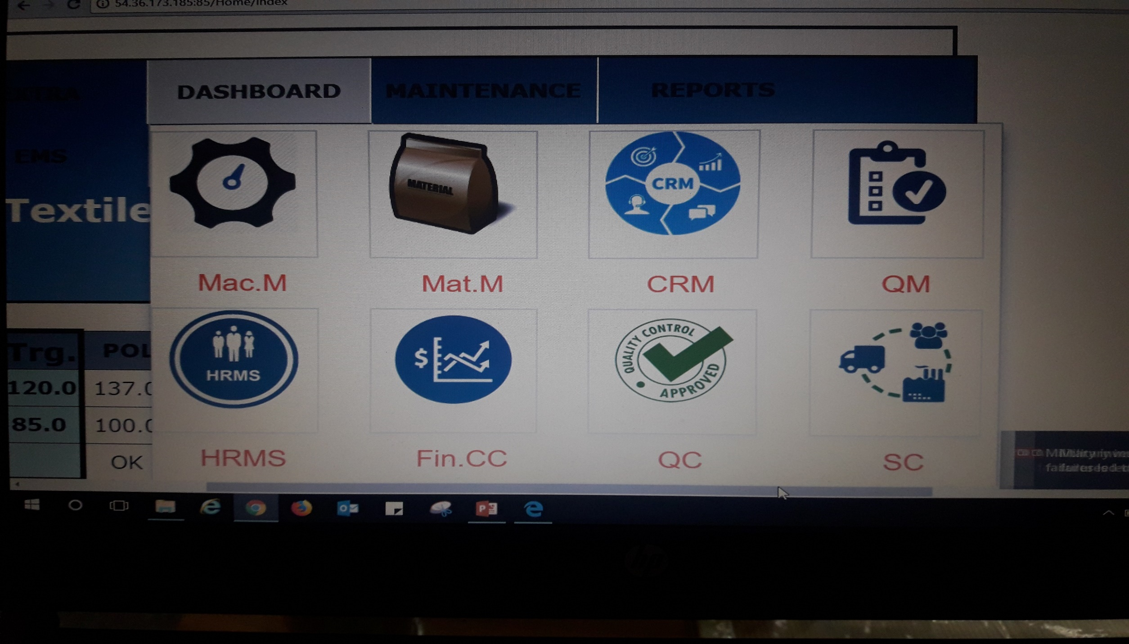
REAL-TIME ERP®

Slide 10
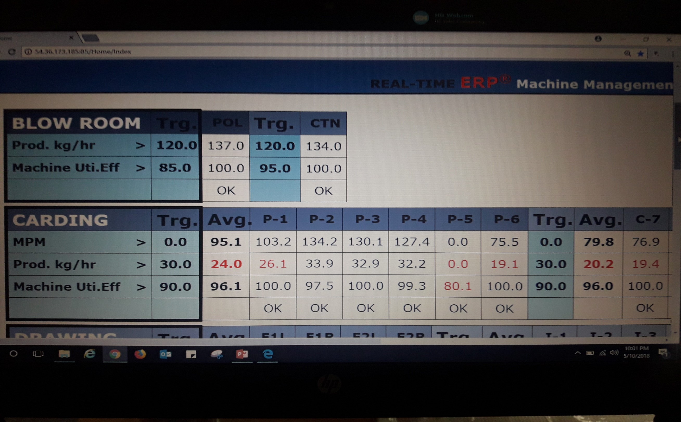

Slide 11
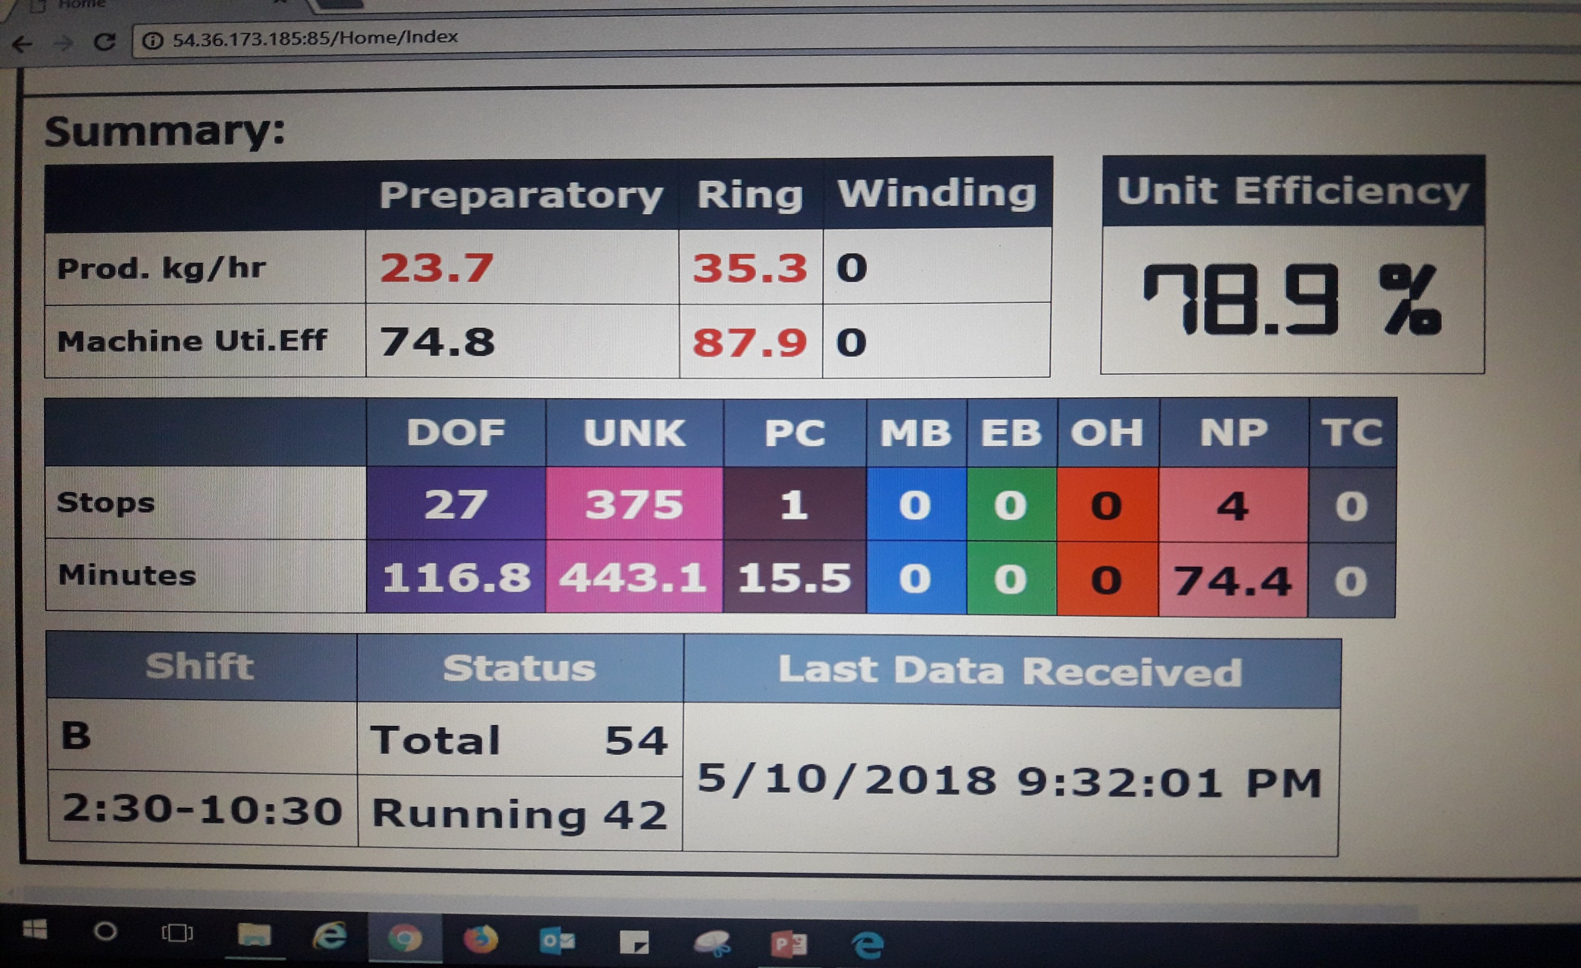

Slide 12
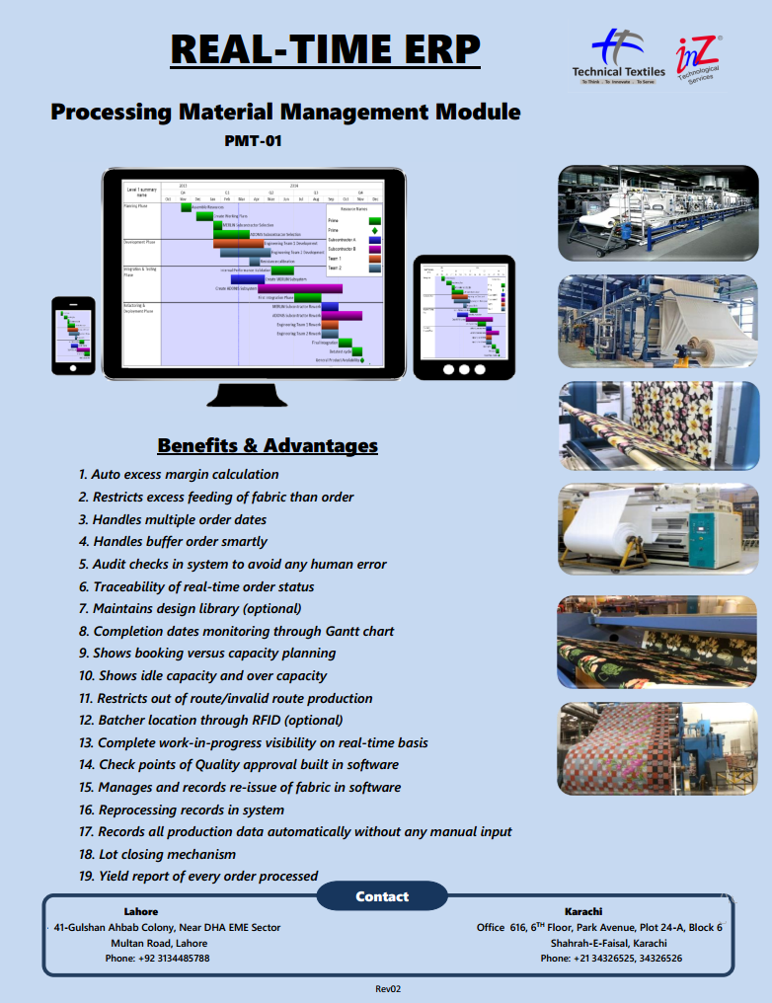
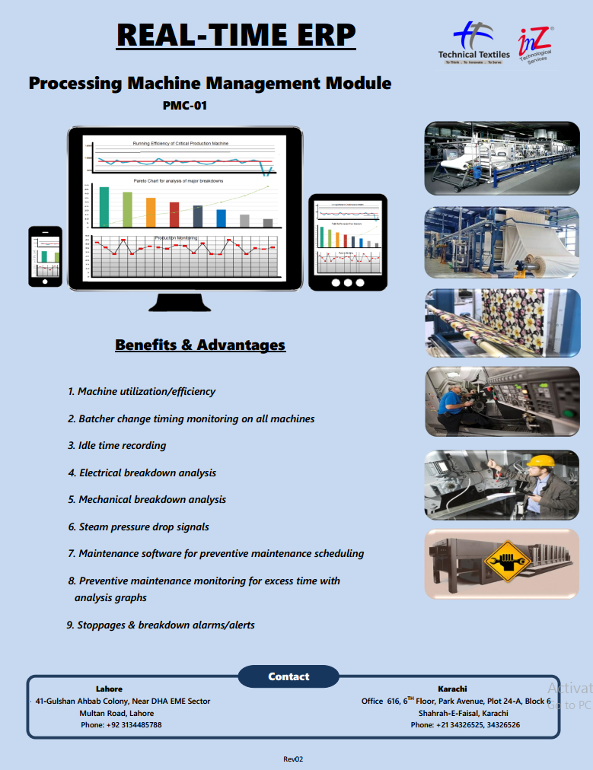
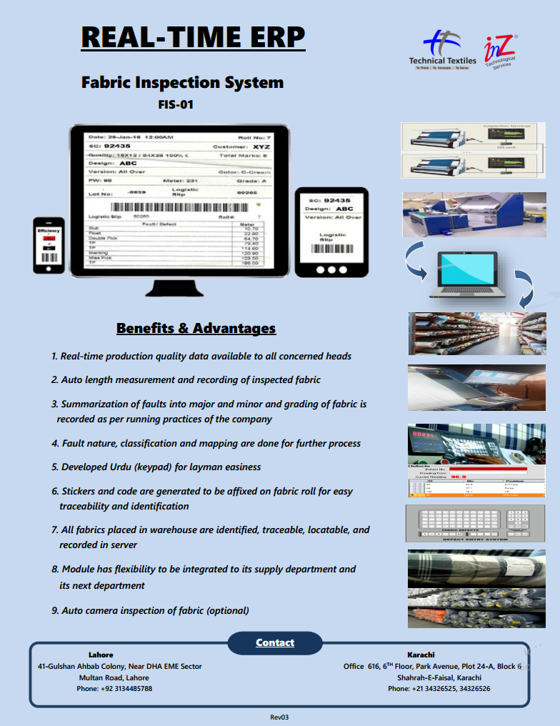
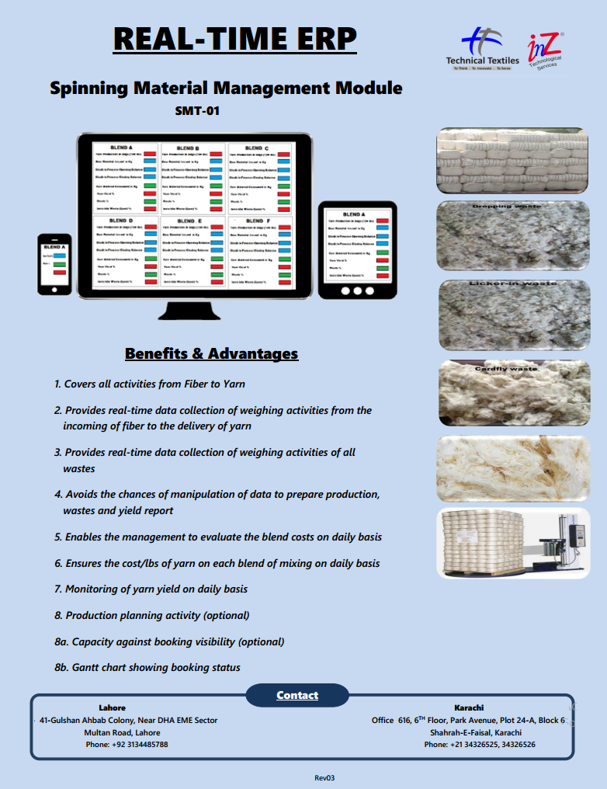
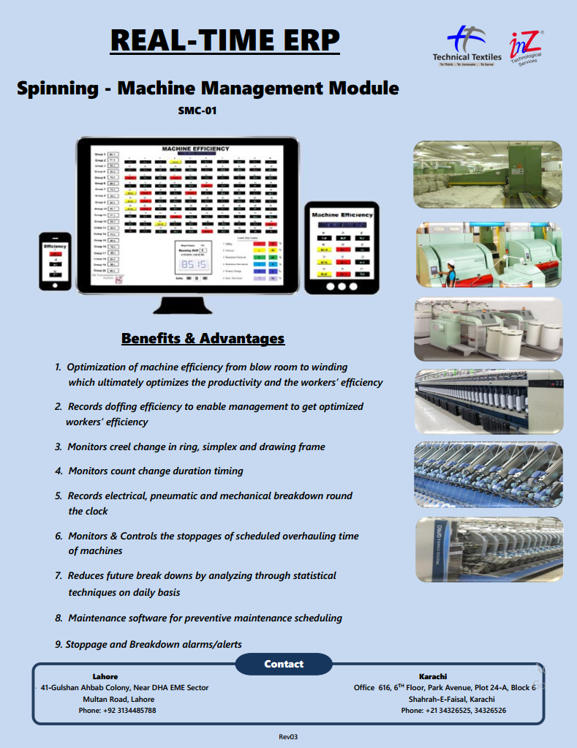
Technical Brochures for modules
REAL-TIME ERP®

Slide 13
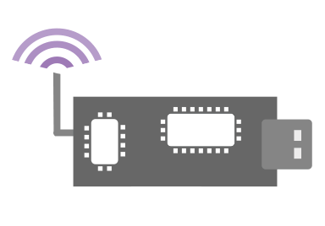

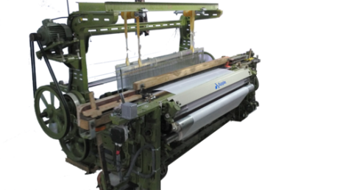
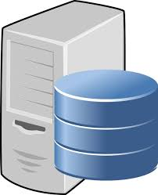


Loom Monitoring System Data-Flow Diagram
REAL-TIME ERP®
Interface Card +Tx
Rx
Data
Real-Time Dashboard
Offline Reports
Database Server
Production
RPM
Efficiency
Loom Status
Stop Downtime
Pick-base
Loom Efficiency
Time-base
Production-base
Quality Description
Beam Consumption

Slide 14
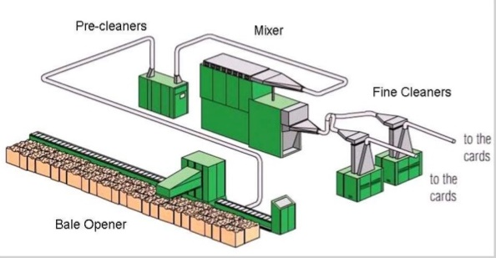
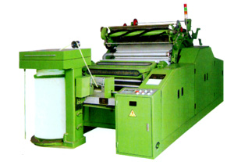
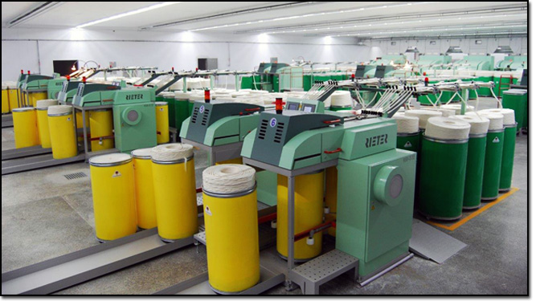
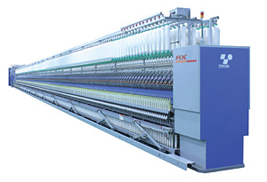
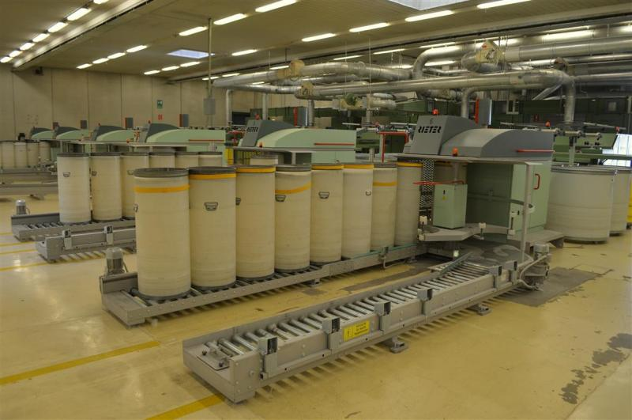
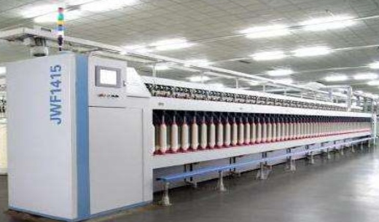
REAL-TIME ERP®
Data
Data
Rx
Data
Data
Data
Database Server
Data

Slide 15
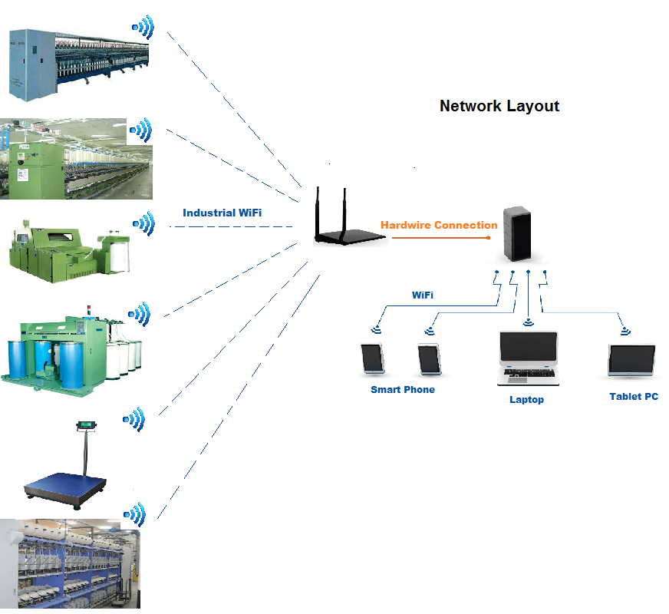
Network Layout
REAL-TIME ERP®

Slide 16
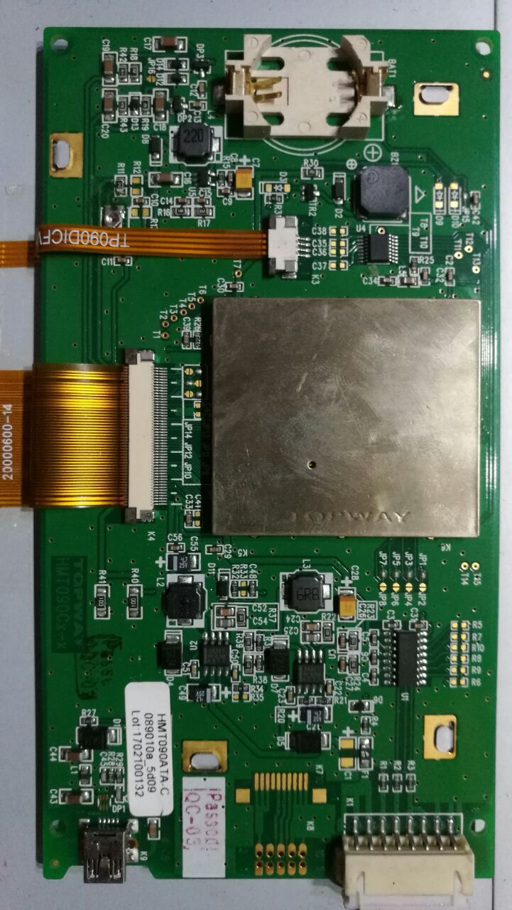
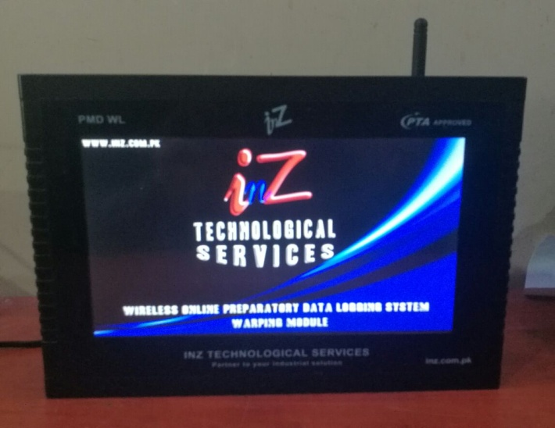
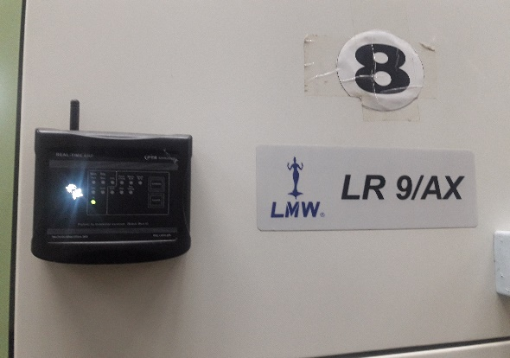
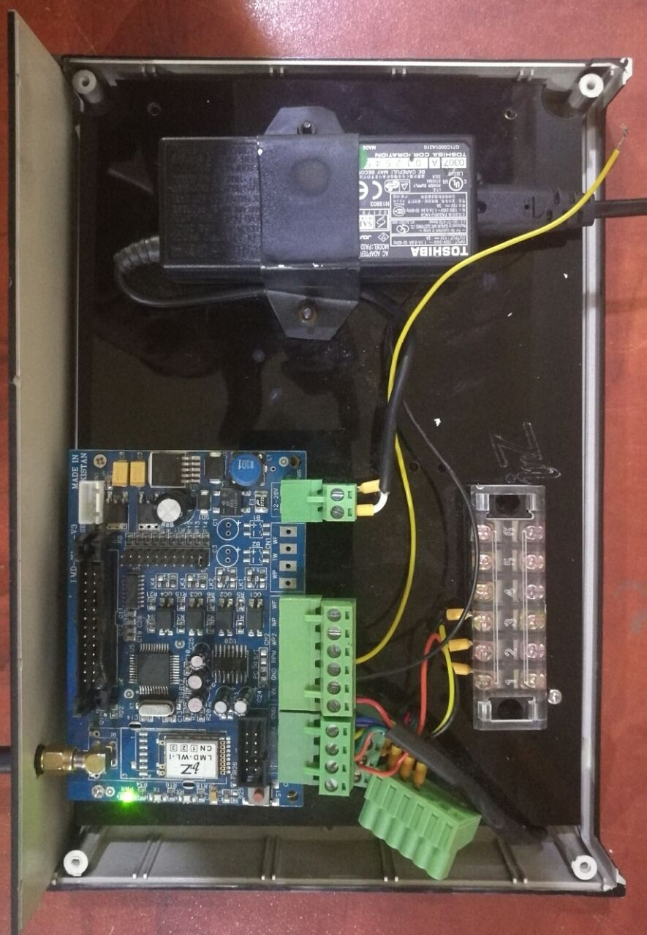
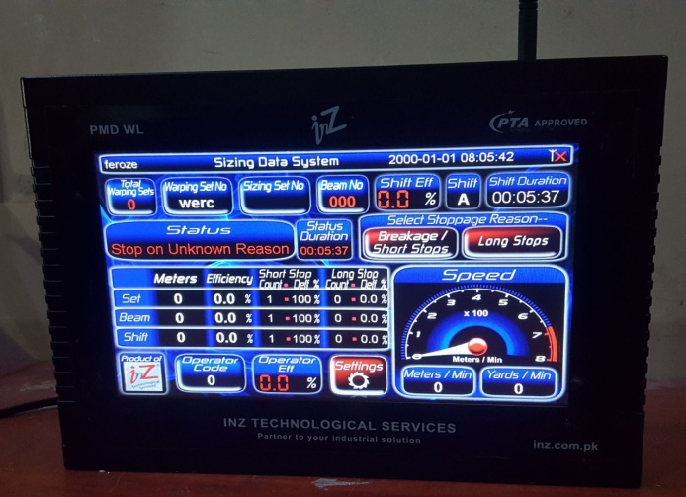
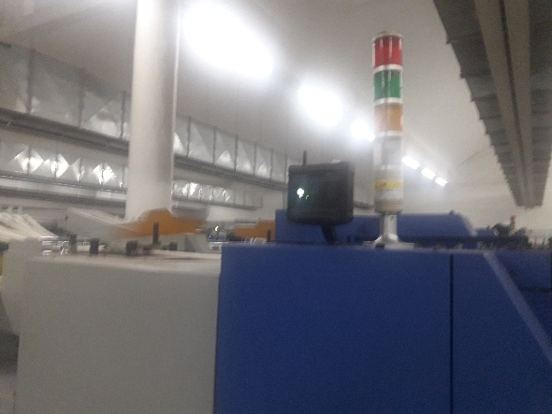
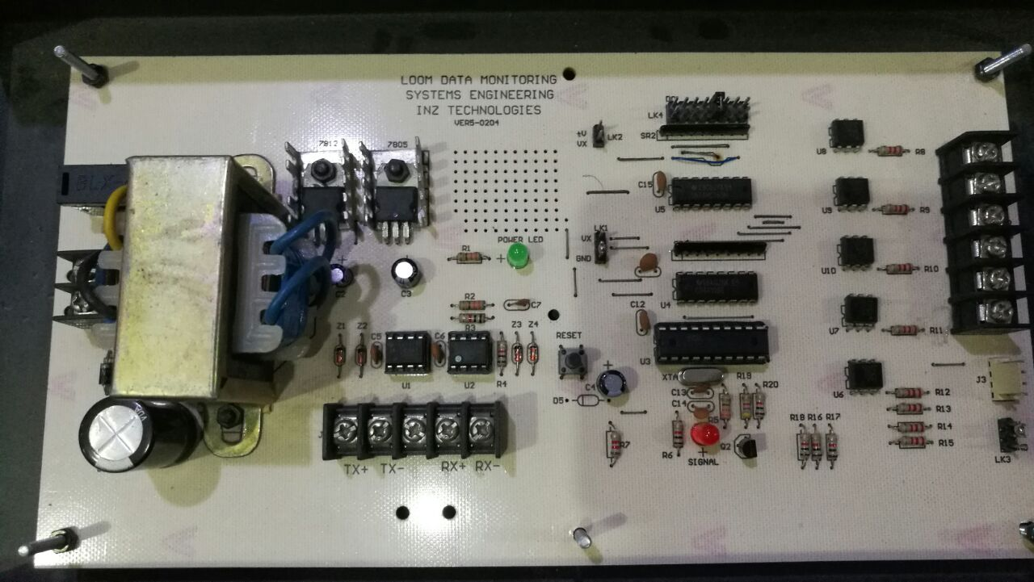
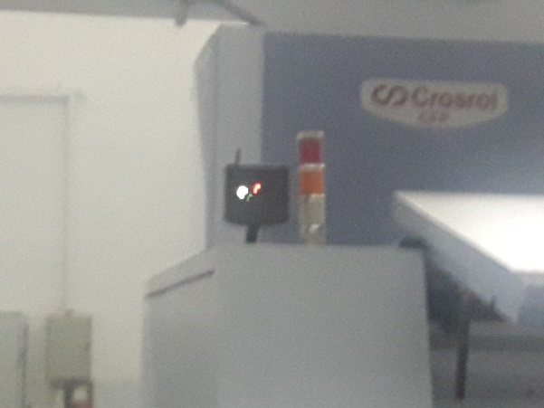
Hardware
REAL-TIME ERP®

Slide 17
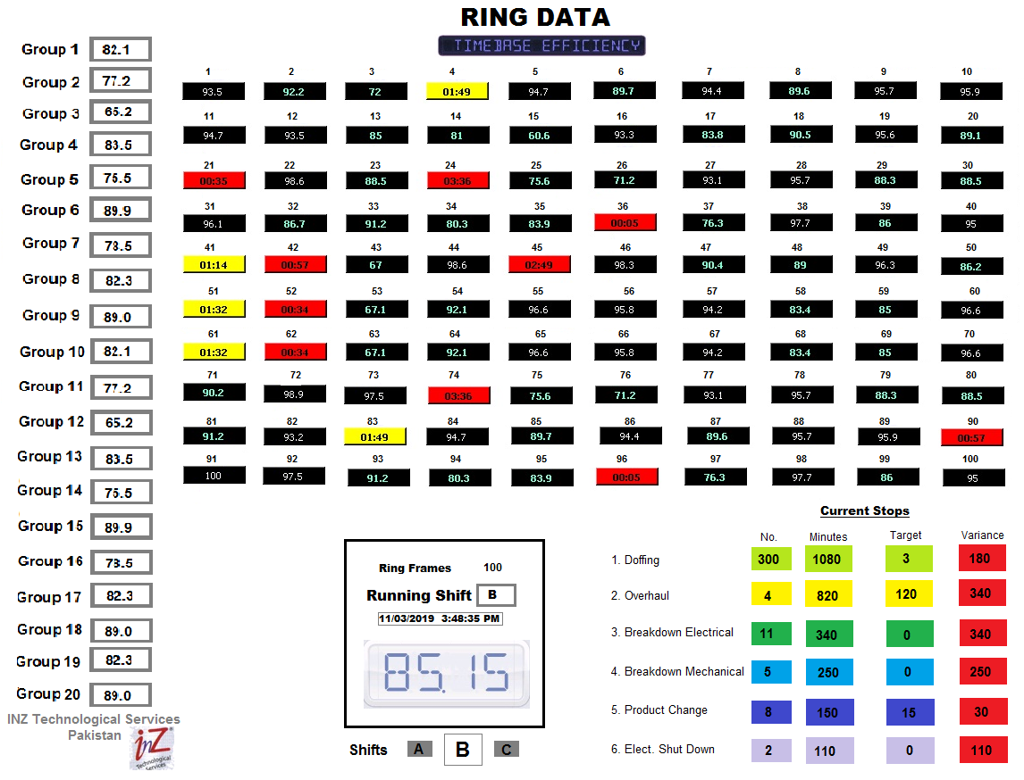
Real-time Ring Data
REAL-TIME ERP®

Slide 18
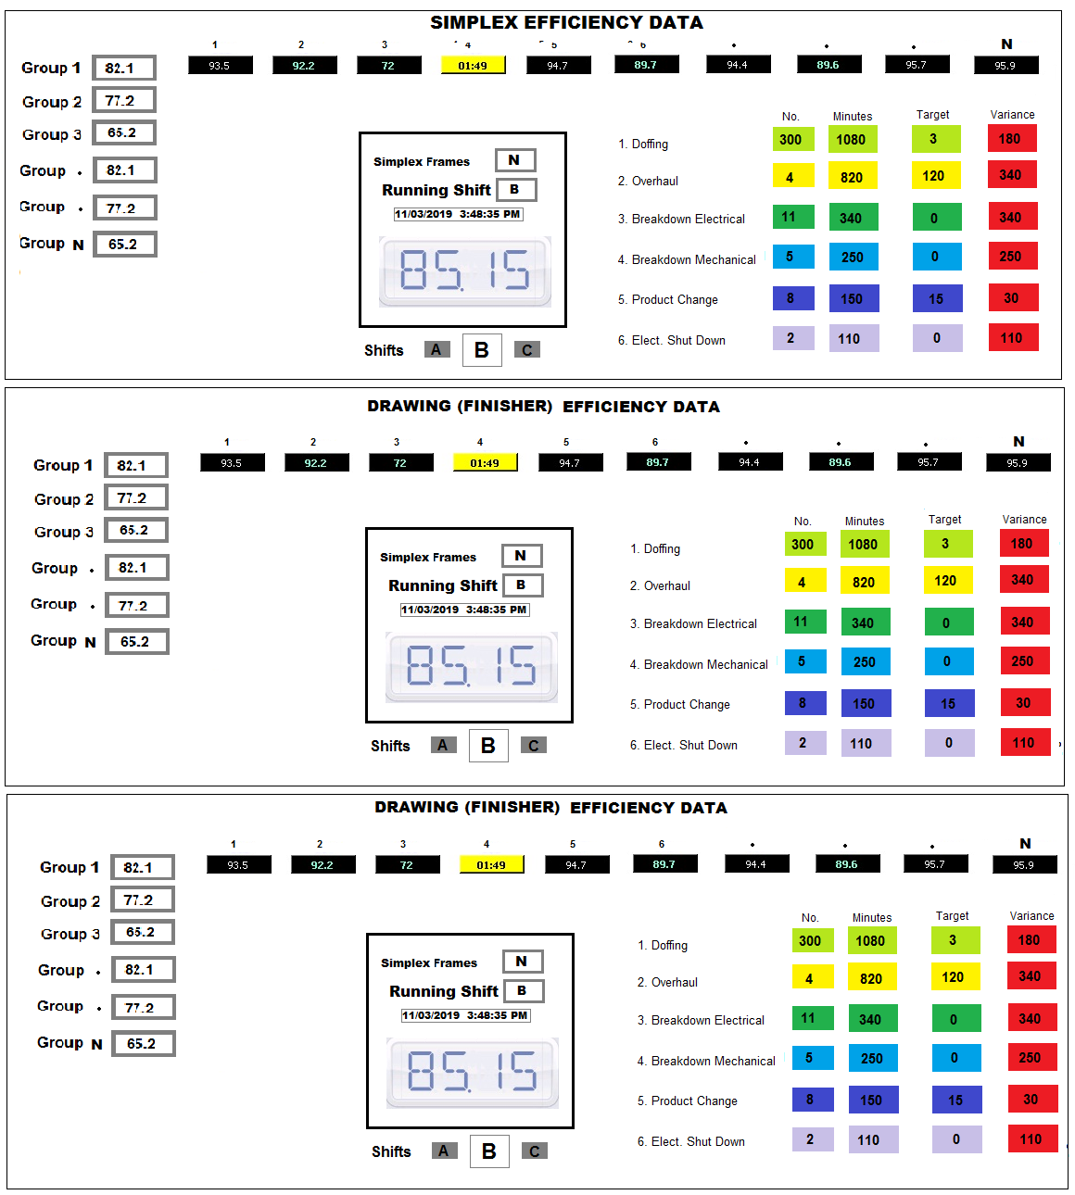
Real-time Drawing Data
REAL-TIME ERP®

Slide 19
Data Collection categorization
REAL-TIME ERP®
 | BlowRoom | Carding | Preparatory | Ring | Winding
On/Off | Auto | Auto | Auto | Auto | Auto
Doffing Time | . | . | Auto | Auto | .
Traveler Change | . | . | . | Auto | .
Overhaul | Man | Man | Man | Man | Man
Mech. Breakdown | Man | Man | Man | Man | Man
Elect. Breakdown | Man | Man | Man | Man | Man
Elect. Shutdown | Auto | Auto | Auto | Auto | Auto
Product Change | Man | Man | Man | Man | Man

Slide 20
REAL-TIME ERP®
REAL-TIME ERP®
Standardi-zation
Optimization Consultancy
SMT
WMT
EMM
PMC
LDS
SDR

Slide 21
REAL-TIME ERP®
Energy Monitoring System (EMS)
Generation | Line Losses/ Transmission Losses | Consumption End | Dash Board & Data Analysis
Total Energy Generated Fuel cost/unit, /engine, /section Maintenance & operational cost/ unit Alarm and alerts against set standards | Energy wastage reduction Identify cable/equipment under or over capacity in use Power Factor monitoring | S-Motors consumption patterns Mixing blends Count Twist Speed Production Weather Alarm for any out of range Department/ section/ S-motor against preset targets. Rerated motors Poor mech. maintenance Poor Elect. maintenance Poor rewinding Poor m/c maintenance | Organization wise Energy Monitoring Program for whole Land Scape. 1Kg yarn production in X units comparison with international and local data Compare Total Units VS Fuel

Slide 22
REAL-TIME ERP®
Energy Monitoring Module (EMS) KPI / PI
Generation | Line Losses/ Transmission Losses | Consumption End | Dash Board & Data Analysis
Total KWh produced Engine Load Fuel cost /unit Fuel cost /engine Fuel Cost /section Maintenance cost/ unit Operational cost/ unit | Line Losses < 1.5 % Temp and eff of transformer, breakers and cables. Etc. Power factor + 90% | Voltage Current KVA KVAR KVARH KW KWH Temp CS Vibration CS | I kg yarn / X units @ Avg Ct. I kg yarn / X units @ Avg machine utilization eff

Slide 23
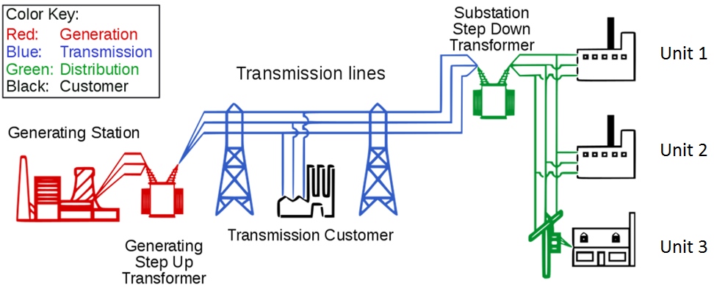
REAL-TIME ERP®

Slide 24
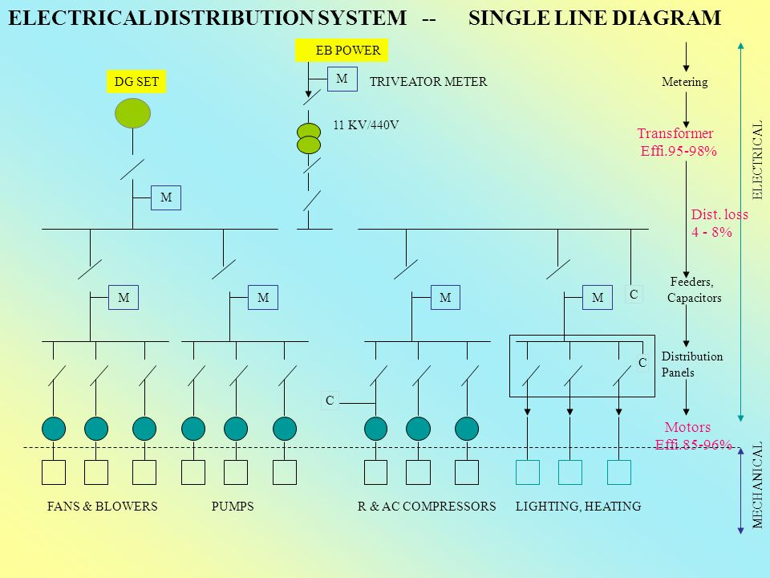
Dash Board EMM
REAL-TIME ERP®

Slide 25



Energy Monitoring System
REAL-TIME ERP®
Monitoring Equipment Choices
Accrescent Engineering Pvt. Ltd Alliance Partners of Schneider Electrical
Solutions Engineers Pvt. Ltd Chinese Brand (Good Quality)
End User Purchase

Slide 26
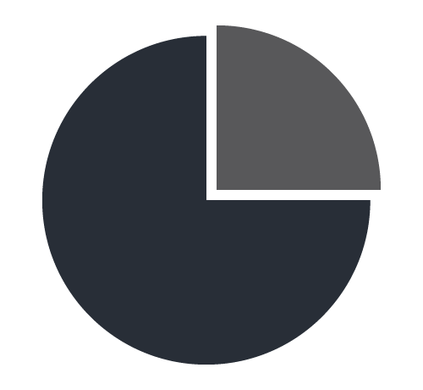
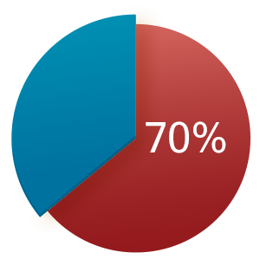
Example of A Spinning Mills for EMS
REAL-TIME ERP®
Mills Data
Name: XYZ Mills
Spindles: 25,000
Total number of motors: 800
Sizes of motors: 1KW to 75KW
Total power required: 2600 KW
Number of motors + 9 KW: 100 Approx
Monitoring Strategy
Criteria for motor monitoring
All critical motors, heavy motors
Motor size + 9 KW
Intermittent motors are not considered
Approx 100 /800 motors on monitoring
25%
Motors Under Monitoring
Power Bill Under Monitoring

Slide 27


REAL-TIME ERP®
Spinning Order Management
Start
Customer Inquiry
Costing Sheet
Customer order PO
ERP Feeding
Stock report
Stocks
Work Order
Mixing Blend
Preparatory
Ring
Production
Winding
Ware House
Gantt Chart
Packing
Dispatch
End

Slide 28
PURCHASE & INVENTORY
REAL-TIME ERP®
Purchase
Start
Purchase Indent
By Dept
Inventory
Finance
Classification
Of Indent 1, 2, 3
3. Import
Items
Approved Suppliers List
1. RFQ Required
2. Direct Purchase for
Approved Supplies
Performa
Invoice
Comparative
Statement
P.O. for Supplier
Goods Arrived
Gate Pass
Delivery Challan
Refuse
Gate Pass
Inventory Report
Payment
Processed
Goods Inspection
Fail
Pass
Accounts
Payable
GRN/Inventory Uploaded
Issue Requisition
Inventory Adjusted
End

Slide 29
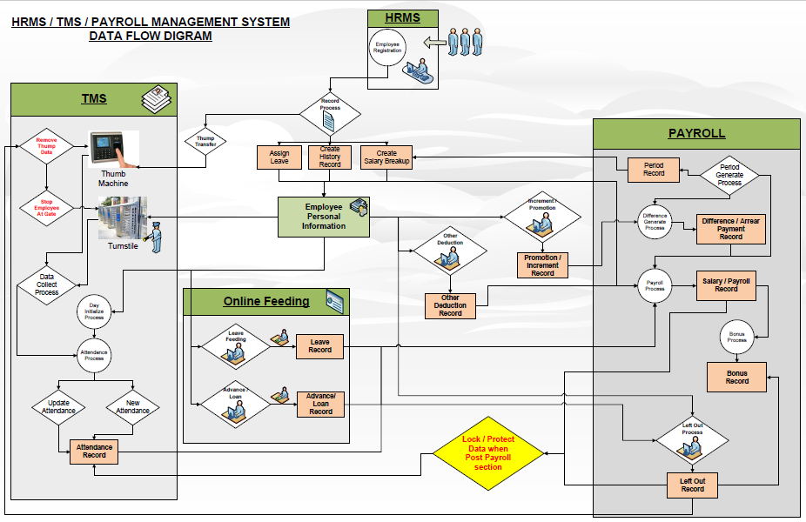
REAL-TIME ERP®

Slide 30
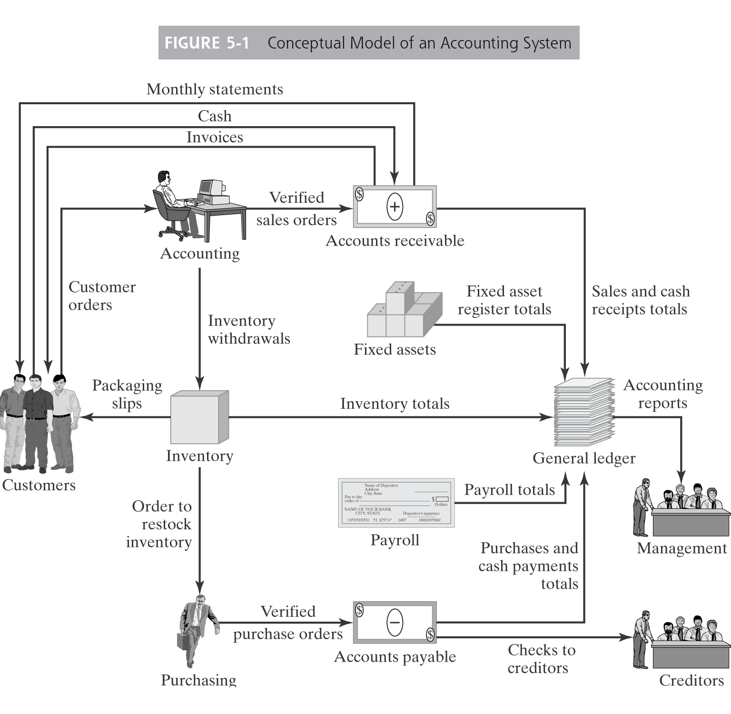
Finance Module
REAL-TIME ERP®

Slide 31
Dashboards
REAL-TIME ERP®
Real-Time Dashboard
Real-Time Activity. Updates every second
No user interaction
Developed on .NET Platform
User Dashboard
For Middle Management Users
Users can apply different interactive filters.
Updates every 30 seconds
Shows present condition only
History data only in reports
Developed on .NET Platform
Management Dashboard
For Executive only. Only graphical info
Mobile App (can customize and prioritize favorites)
Updates every 4 hours
Developed on Oracle BI

Slide 32
Benefits for Machine Management Modules
REAL-TIME ERP®
Improves Machine Utilization Efficiency
Optimization of every productive machine efficiency which ultimately improves
overall productivity and worker’s efficiency Decrease Stoppages
Records REAL-TIME machine efficiencies and deficiencies
Records electrical, pneumatic and mechanical breakdown round-the-clock
Monitors & controls the stoppages of scheduled overhauling, product change,
Effective Maintenance
Maintenance software for preventive maintenance scheduling
Reduces future breakdowns by analyzing through statistical techniques on daily basis
Preventive maintenance monitoring for excess time with analysis graphs Raises Alarms & Alerts
Stoppage and Breakdown alarms/alerts

Slide 33
Benefits for Material Management Modules
REAL-TIME ERP®
Order Management
Maintains record from order booking, to production to dispatch of goods
Gantt chart shows booking status and completion dates of orders
Capacity against booking visibility. Shows idle capacity and over capacity
Handles buffer orders, Handles multiple order at a time smartly
Traceability of real-time order status
Restricts out of route/invalid route production
In processing batcher location through RFID (optional) Production
Records all production data automatically without any manual input
Avoids chances of manipulation of data to prepare production, wastes and yield report
Maintains product library by customer, code, blend, design etc. Yield
Yield report of every order processed available on system.
Restricts excess feeding of raw material then calculated as per production plan.
Reprocessing of material is records in system

Slide 34
Added Benefits Material Management Modules for Spinning Mills
REAL-TIME ERP®
Raw Material (Cotton )
Cotton purchase plan for the year.
Maintains record for booked , in transportation, arrived and balance cotton to purchase.
Maintains record of cotton weight variation purchase verses arrived and issue to Blow room.
Quality record of the cotton to be maintained on real time.
All cotton related information available on mobile and tablets through dash board.
Every cotton bale movement can be traced on auto by using RFID (optional with extra cost)
Cotton Blend mechanism is done by software to produce cotton issue requisition to Blow room.
Yarn
Yield of every blend is available on real time with figures of WIP.
Yarn weight variation to be monitored on auto.
Every yarn bag and pallet will be issued a identification sticker for easy traceability.

Slide 35
Process of Sales & Implementation of ERP
REAL-TIME ERP®
1
Introduction / Presentation
2
Module Selection
3
Q/A
(macro-level requirement collection)
4
Quote Price
5
Negotiation/Finalization
6
Detailed Survey
(micro-level requirement collection)

Slide 36
REAL-TIME ERP®
8
Hardware installation
9
Software Deployment
10
Print Reports
11
Trainings
12
Closing of Project / Customer Feedback
7
Hardware / Software minor changes as per Customer needs
Dashboard

Slide 37






Module platform
REAL-TIME ERP®
Data Collection from Machines Special developed Hardware by us
Data Platform Oracle
Front end / dashboards .NET Framework
Management Dashboard Oracle BI / .Net
Report generation Oracle
Mobile app Oracle Business Intelligence Mobile
Networking Wi-Fi 2.4 GHz & INZ 2.480 GHz ( PTA Approved)
International organization for developing and implementing standards for Wireless Communication
Specialized protocol for Industrial Wireless Communication High speed High Capacity/Bandwidth Resistant to interference Effective long range communication

Slide 38
Classification of Manufacturing Industries
REAL-TIME ERP®
Process Industry
Bulk Production
Batch Production
Discrete Industry
Assembly line
In pieces
Runs, round the year
Buffer Production
Fixed Cost 60% Variable Cost 40%
Mostly, First Production then Sale
e.g. Cement, textiles, chemical, food, etc.
Order to Order
Make to Order
Fixed Cost 10% Variable Cost 90%
Mostly, First Sale then Production
Purchase is based on BOM
Purchase based on Season
e.g. Car assembly unit, machine manufacturing
Production Style
Units of Measurement
Running Time
Production Strategy
Finance
Sales
Strategy
Purchasing
Examples

Slide 39













ERP providers in Pakistan
REAL-TIME ERP®
SAP
A1
B1
Leonardo
R/3
TekLogix
Computer House Italy
Innovative Channels
DataTex Switzerland
Sage England
Porini SRL Italy
VisionPLUS
Jaffer

Slide 40
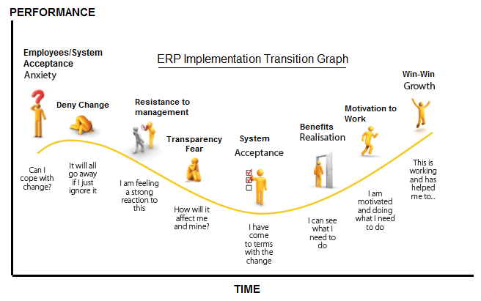
ERP infusion
REAL-TIME ERP®

Slide 41
SAP vs REAL-TIME ERP®
Real Time
Machine indignation
Effectiveness
Less HR , Increase productivity
Depth
Generic for every industry
ITL / Khas
ERP
E = Enterprises ( Profitable Organization )
R = Recourse ( Machine + Man + Material )
P = Planning ( Future course of action )

Slide 42
Contacts
REAL-TIME ERP®
Karachi Office:
Office# 616, 6th Floor Park Avenue, Shahrah-E-Faisal Karachi, Pakistan
Tel: +92-21-34326525, Fax: +92-21-34326527
Lahore Office:
41 Gulshan Ahbab DHA EME Sector Multan Road Lahore, Pakistan 53711
Tel: +92-300-8348702, +92-313-4485788

